Slide 1
Title: Exploratory Data Analysis of Amazon Books Dataset
Subtitle: "Insights and Visualizations“
Name: Swetha .S

Slide 2
Introduction
Overview of the Dataset:
"The dataset contains information about 2000 books, including attributes like title, author, price, rating, reviews, category, and publication date."
"The data is simulated using the Faker library to represent a range of books found on e-commerce platforms."
Objective:
"The goal is to perform exploratory data analysis (EDA) to uncover trends and insights about book prices, ratings, reviews, categories, and more."

Slide 3
Why We Need This Data
Key Points:
Consumer Insights: Understand reader preferences, popular genres, and price trends.
Informed Decisions: Enable publishers, authors, and retailers to optimize pricing, marketing, and content strategies.
Emerging Opportunities: Identify growing categories and market trends for new book releases.
Customer Satisfaction: Improve personalized recommendations and enhance user experience based on ratings and reviews.
Business Growth: Drive better outcomes through data-driven strategies and competitive analysis.

Slide 4
Visuals:
Use an icon-based design with visuals representing key points (e.g., a magnifying glass for insights, a graph for trends, a heart for customer satisfaction).
Infographic style to keep it clean, simple, and visually engaging.
Call to Action:
"Leverage this data to make smarter decisions in the book market!"

Slide 5
Data Cleaning and Preparation
Steps Taken:
"Converted 'Publication Date' to a datetime format for proper analysis."
"Handled missing or invalid data by dropping rows with missing values."
Data Quality Check:
"The dataset was cleaned to ensure no missing or inconsistent values remained before analysis."
Visual (Optional):
Show a small table with a few cleaned records from the dataset

Slide 6
Dataset Overview
Basic Statistics:
The dataset contains 2000 records with various attributes such as Title, Author, Price, Rating, Reviews, and Category.
The average price of a book is $30, with ratings ranging from 1 to 5.
Visual:
Show a summary statistics table or a descriptive analysis from df.describe().

Slide 7
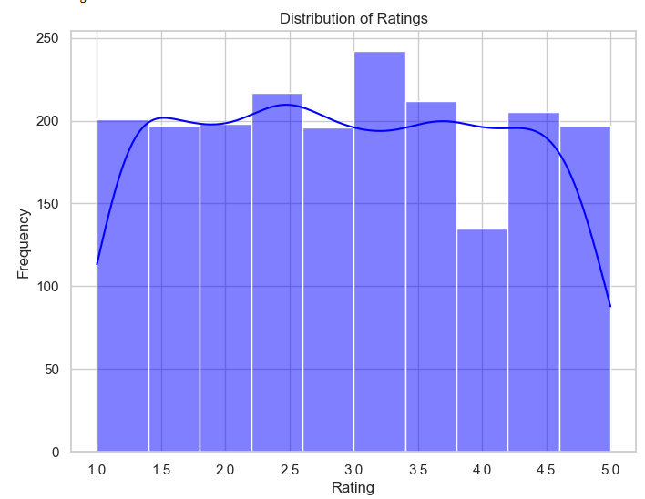
Distribution of Ratings

Slide 8
Findings:
"The majority of books tend to have ratings between 3 and 5, with a slight peak around 4."
"This indicates that most books in the dataset are well-received.“
Visual:
Include the rating distribution histogram to show the spread of ratings.

Slide 9
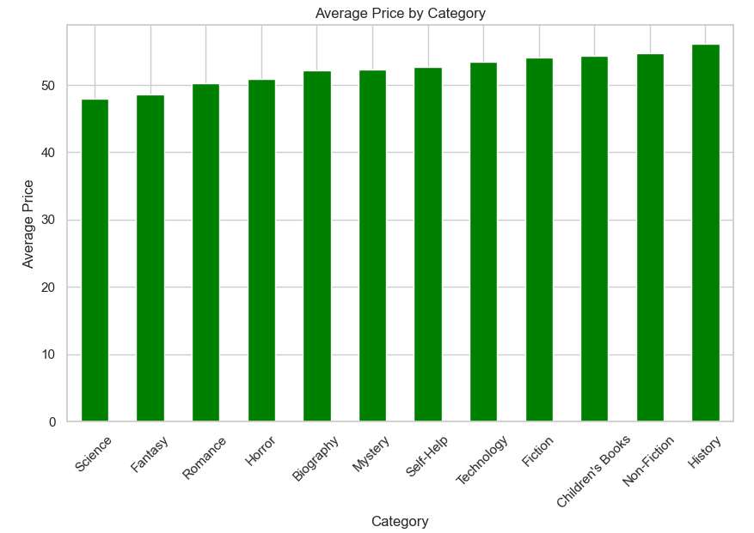
Average Price by Category

Slide 10
Key Insights:
"The most expensive categories are typically 'Technology' and 'Science,' while 'Children's Books' and 'Self-Help' have lower average prices."
"This suggests that books in niche categories like technology and science often come with higher price points due to specialized content."
Visual:
Include the bar plot showing the average price by category

Slide 11
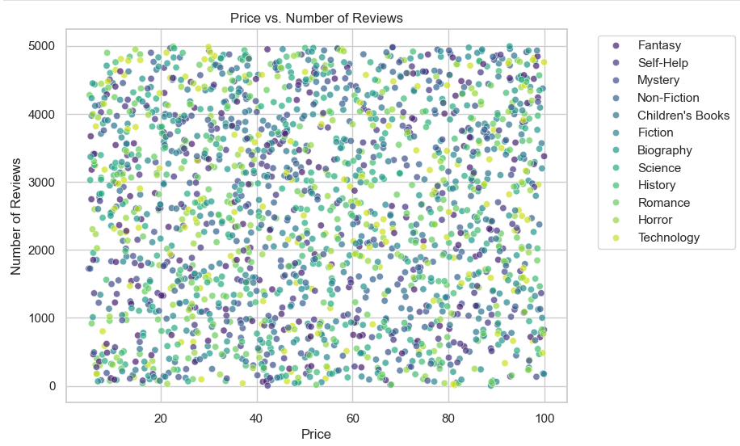
Price vs. Number of Reviews

Slide 12
Analysis:
"Books with higher prices do not necessarily have more reviews, indicating that the price of a book does not directly correlate with its popularity."
"The scatter plot suggests that while popular books may have more reviews, their price does not follow a clear linear trend."
Visual:
Include the scatter plot of price vs. number of reviews, highlighting the lack of a clear pattern.

Slide 13
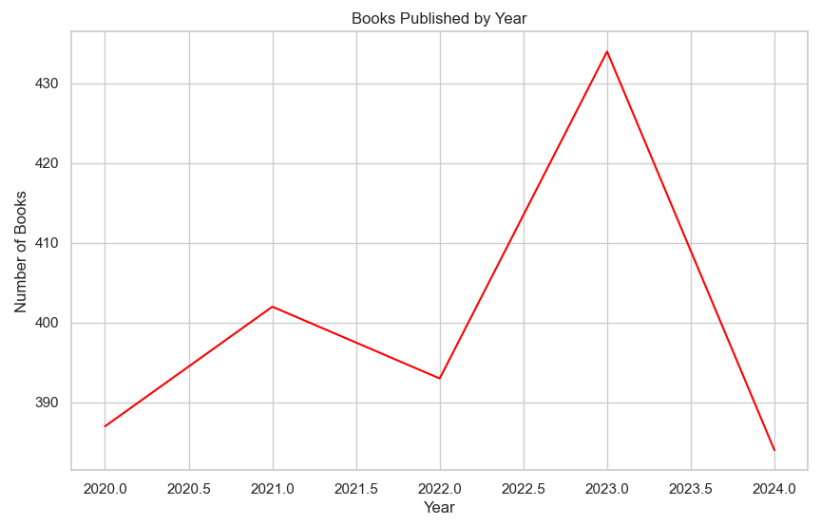
Books Published Over Time

Slide 14
Analysis
Mention that the line plot shows that the number of books published has remained steady over time. This suggests a consistent pace of book releases, without significant spikes or drops in the past decade.
This line plot also shows the books popularity time period.

Slide 15
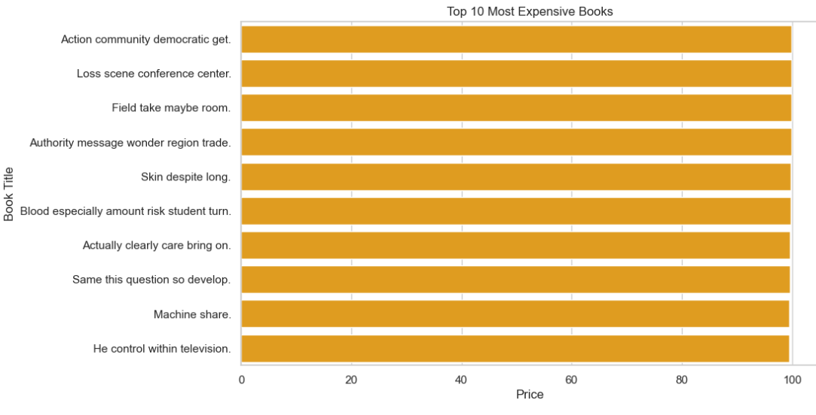
Top 10 Most Expensive Books

Slide 16
Findings:
"The most expensive books in the dataset are typically those in the 'Technology' and 'Science' categories."
"These books are often textbooks or specialized content that require higher production costs."
Visual:
Show the bar plot of the top 10 most expensive books

Slide 17
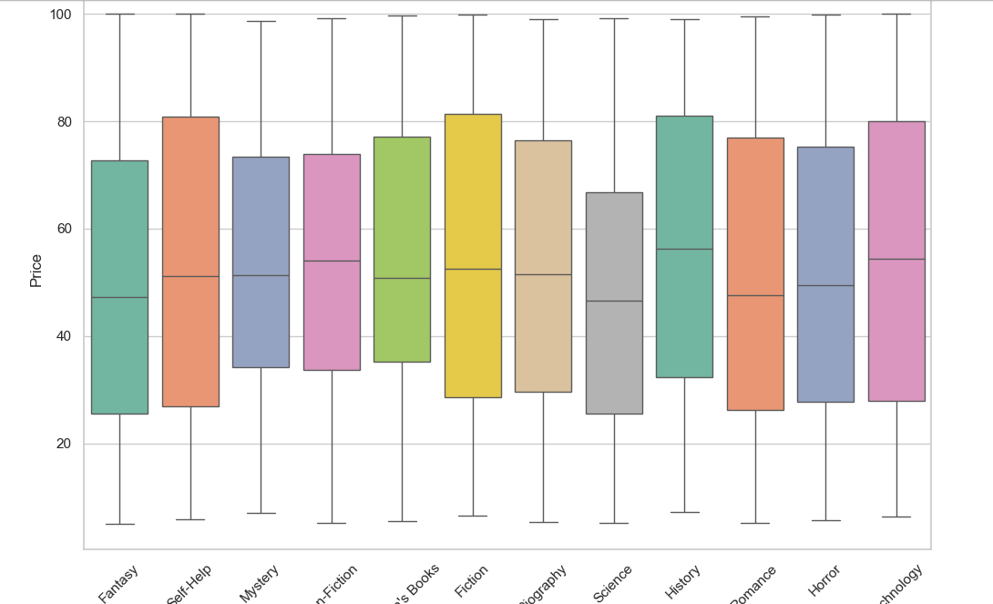
Category-wise Rating Distribution

Slide 18
Key Insights:
"The ratings are quite consistent across different categories, with most categories showing a similar range of ratings."
"However, 'Mystery' and 'Horror' categories have slightly lower ratings on average compared to others."
Visual:
Include the box plot of ratings by category.

Slide 19
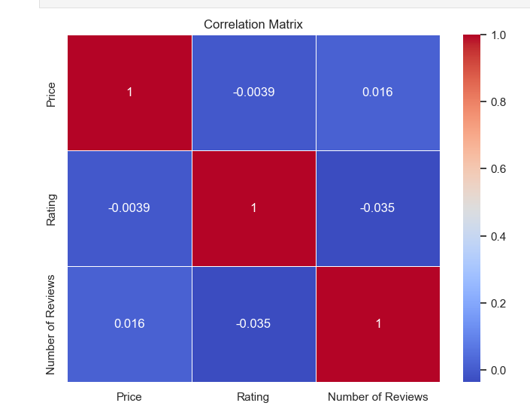
Correlation Analysis

Slide 20
Findings:
"There is a weak correlation between price and rating, suggesting that higher-priced books are not necessarily better rated."
"The number of reviews has a slightly stronger correlation with rating, indicating that books with more reviews tend to have better ratings."
Visual:
Include the heatmap showing the correlation between price, rating, and reviews.

Slide 21
Conclusion
Summary of Key Insights:
"The dataset revealed several interesting trends about book pricing, ratings, and reviews."
"Expensive books tend to fall into specialized categories like 'Technology' and 'Science,' while ratings are mostly clustered towards the higher end (3.5-5)."
"No strong correlation was found between price and rating, but reviews seem to be a more reliable indicator of book quality."
Learnings:
"The analysis provided insights into how books are priced, rated, and reviewed across different categories."
"This information could be useful for authors, publishers, or e-commerce platforms to better understand pricing trends and customer preferences."

Slide 22
Future Work/Recommendations
Further Analysis:
"Analyze the relationship between author reputation and book ratings."
"Examine regional price differences or trends in book publishing by location."
Recommendations:
"Authors could focus on writing in high-demand genres like 'Science' or 'Technology' to price their books higher."
"Publishers could explore price strategies based on category popularity."

Slide 23


